Slide 1
CMPE-275
Team - 08
Python Dask
Presented by :
Shalab Neema
Pratyush Sharma
Under Guidance of :
Prof. John Gash

Slide 2
Background
What is Dask?
Why Dask should be used ?

Slide 3
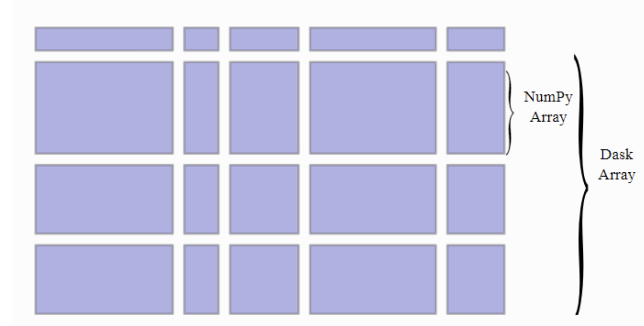
Data Types:
Array:
DataFrame:
Bag:

Slide 4
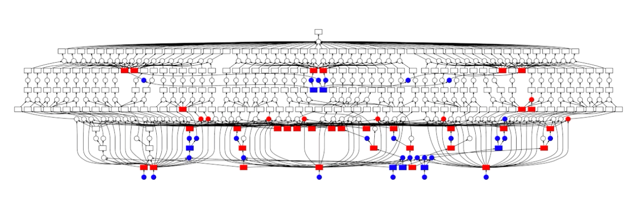
Visualizing:

Slide 5
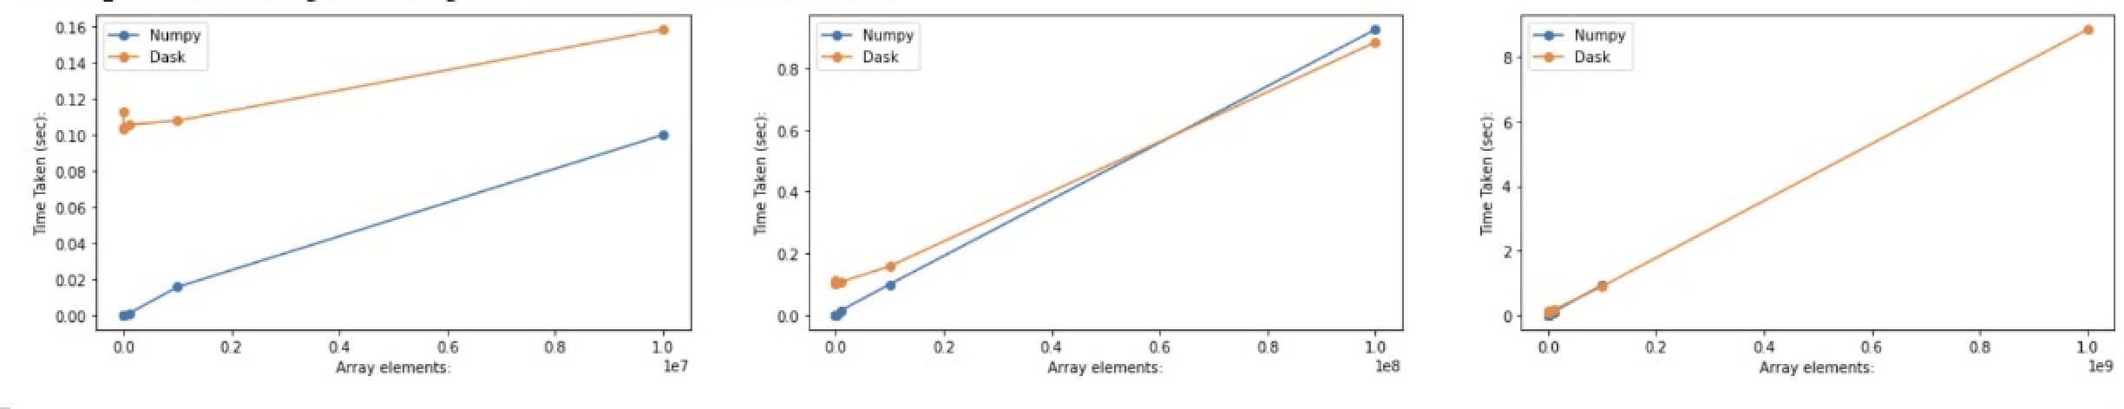
Code Implementation:

Slide 6
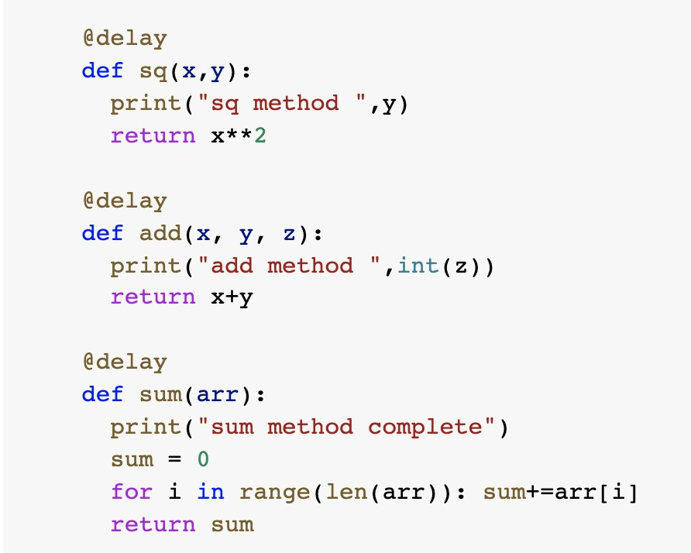
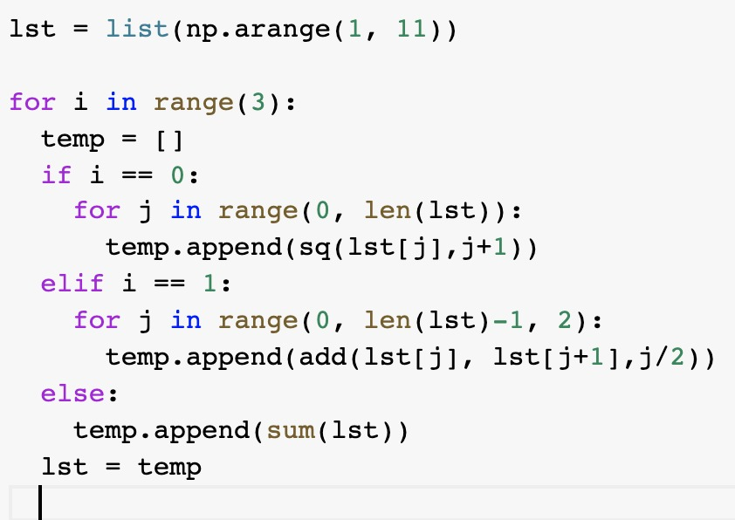
Dask Delay- Lazy Evaluations

Slide 7
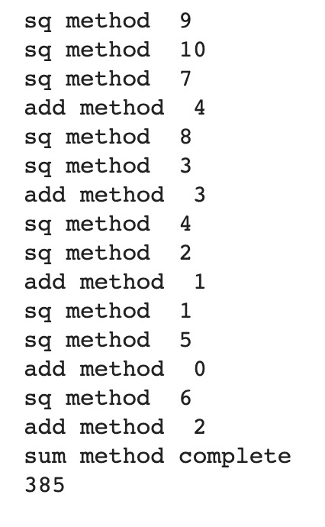
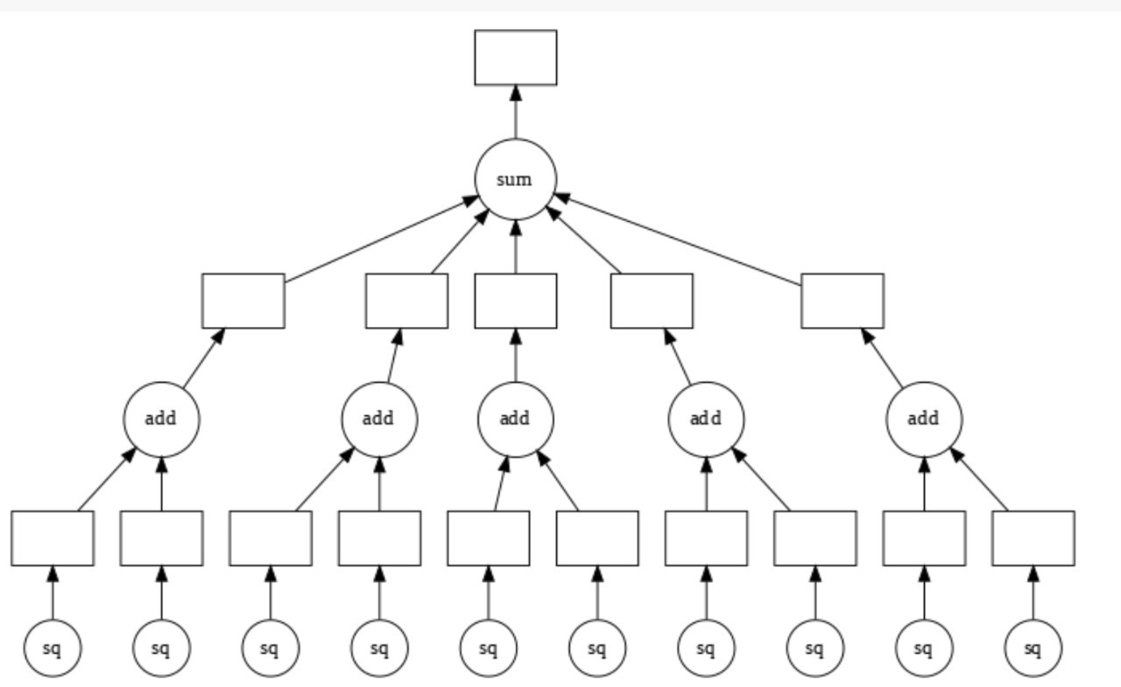
Graph Visualization:

